Slide 1
Serverless Architecture with Azure Funcitons
by Juanjo Cerezuela
@PliyoSan

Slide 2


Slide 3
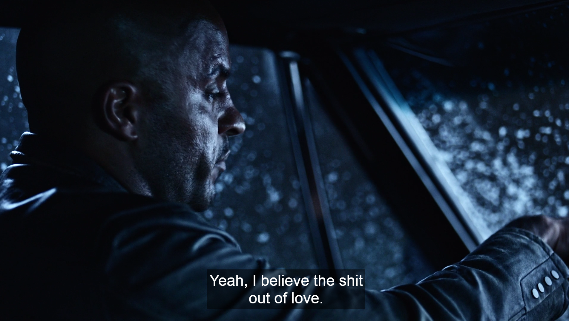

Slide 4
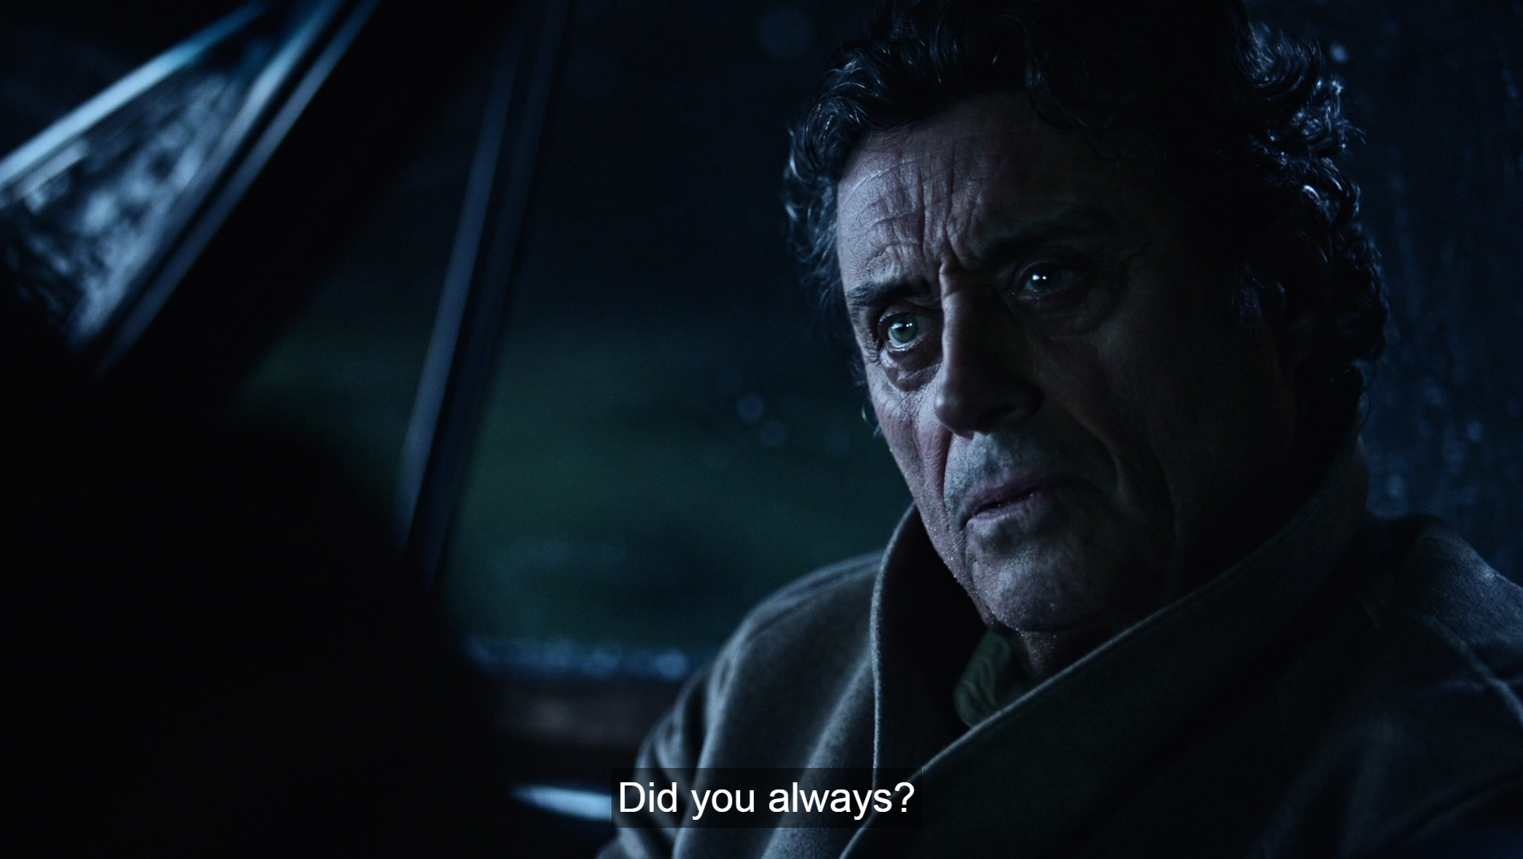

Slide 5
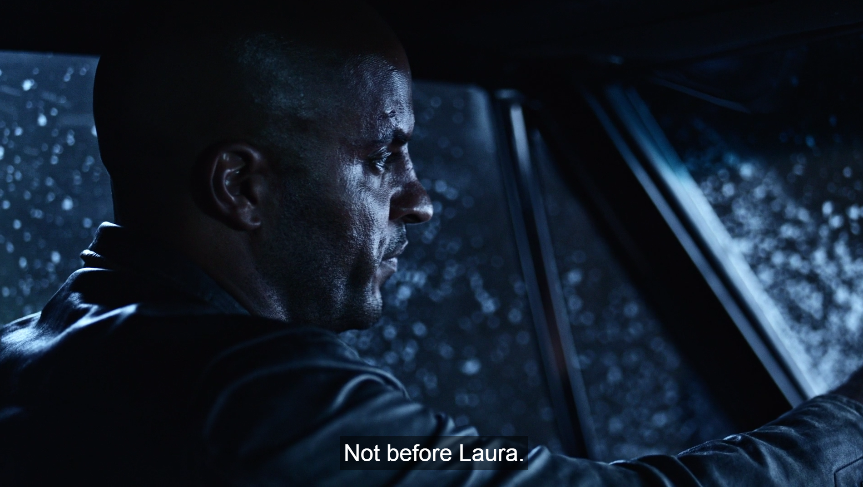

Slide 6


Slide 7


Slide 8
BUT THAT’S NOT WHAT WE CAME TO TALK ABOUT

Slide 9
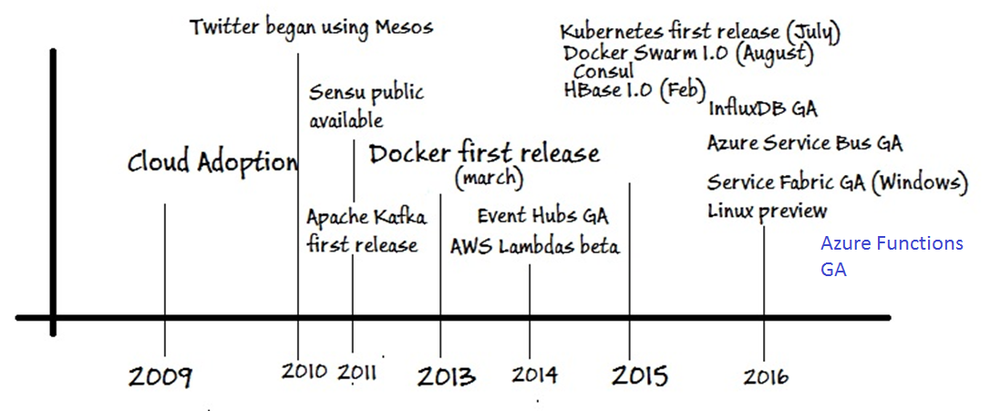
Where are we coming from?

Slide 10
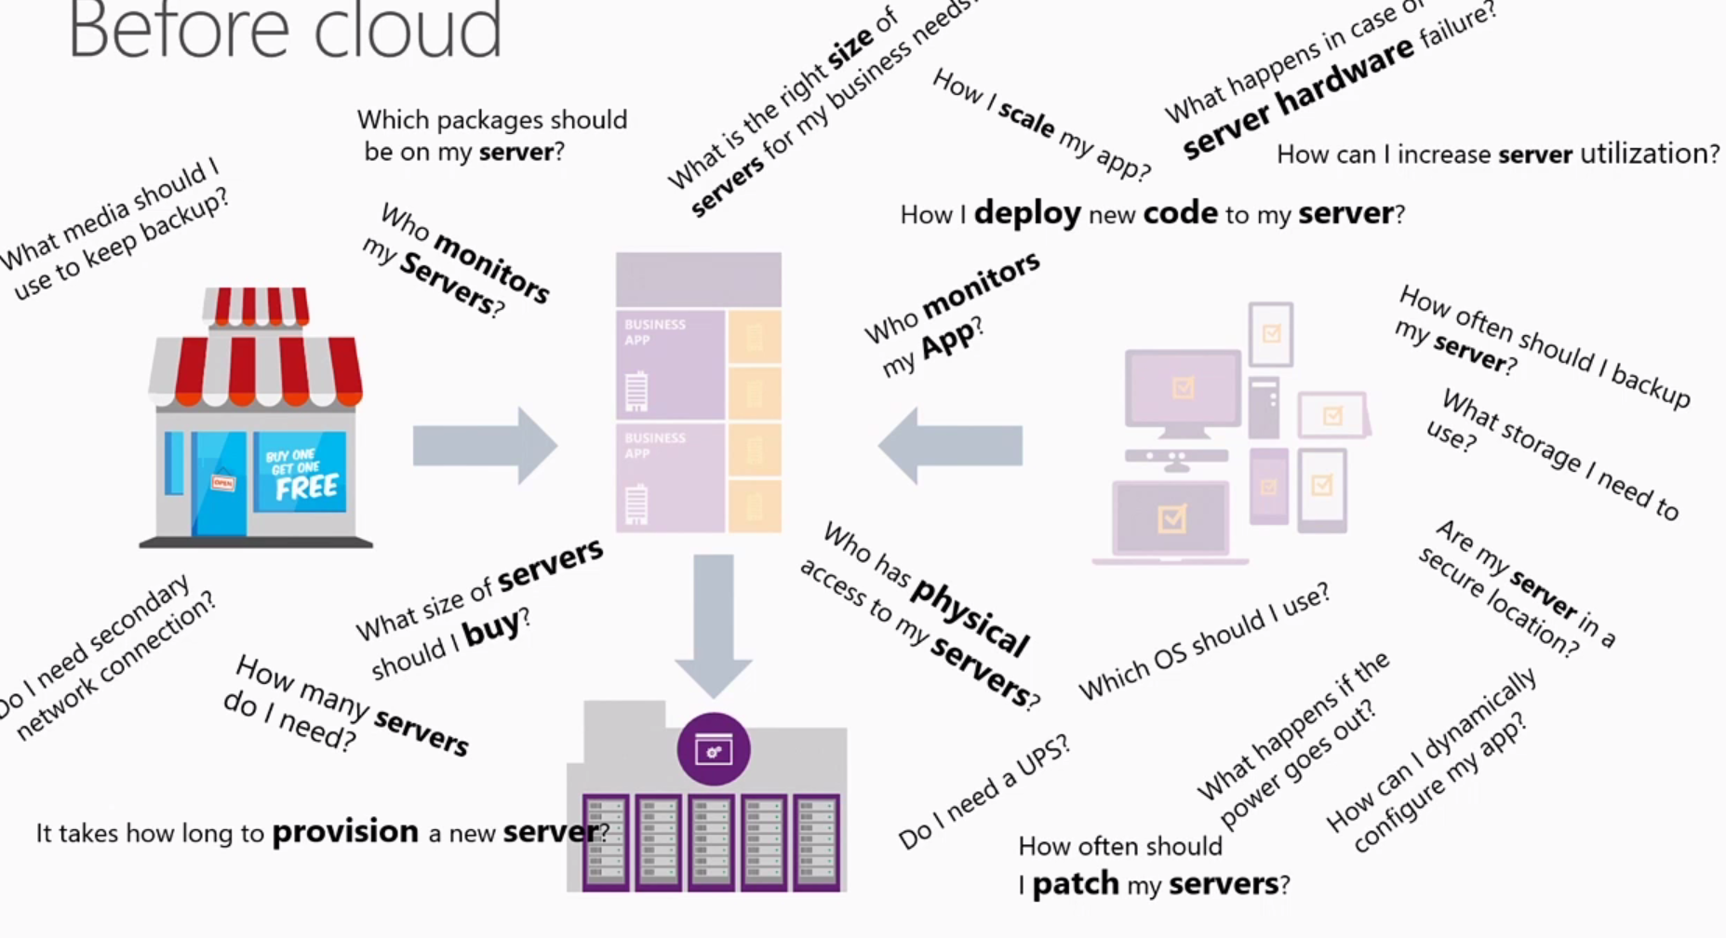
Where are we coming from?
Source: Building serverless applications With Azure

Slide 11
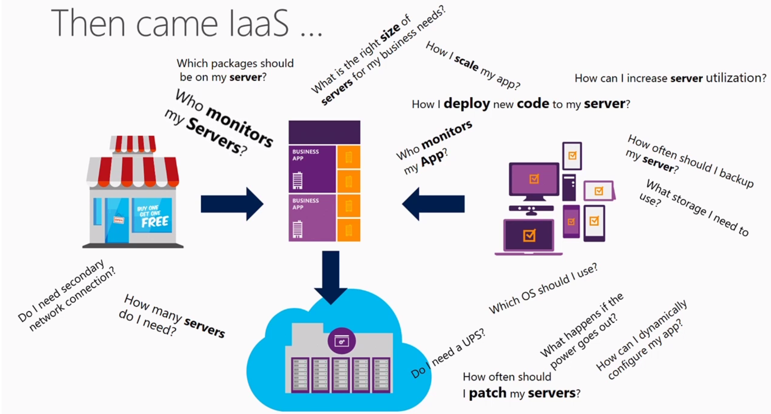
Where are we coming from?
Source: Building serverless applications With Azure

Slide 12
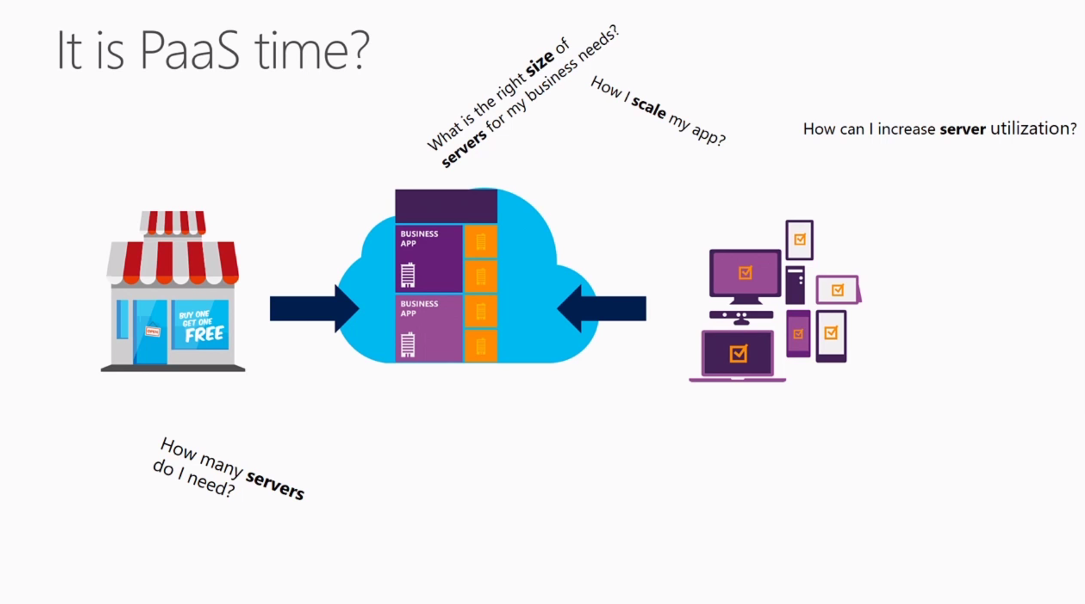
Where are we coming from?
Source: Building serverless applications With Azure

Slide 13




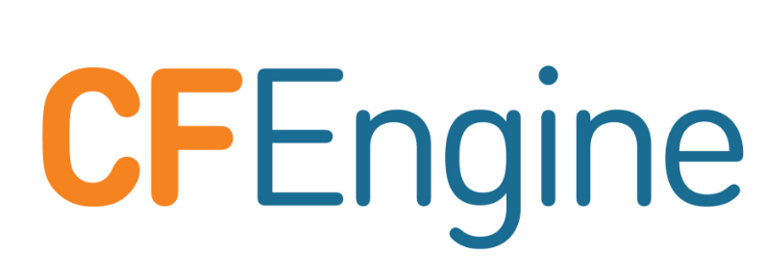
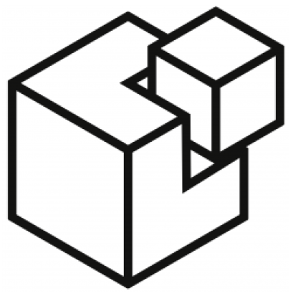
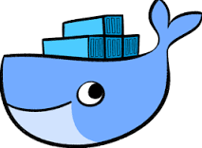
Where are we coming from?

Slide 14
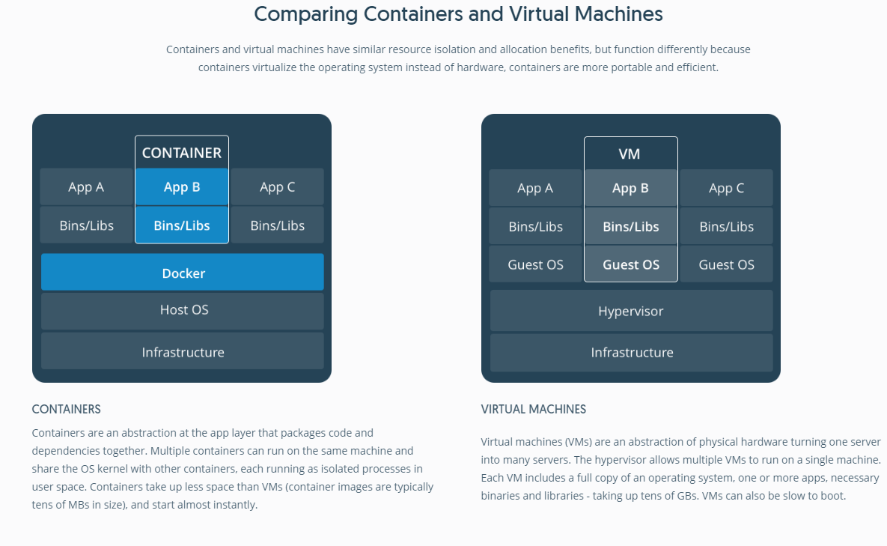
Source: What is a Container?

Slide 15
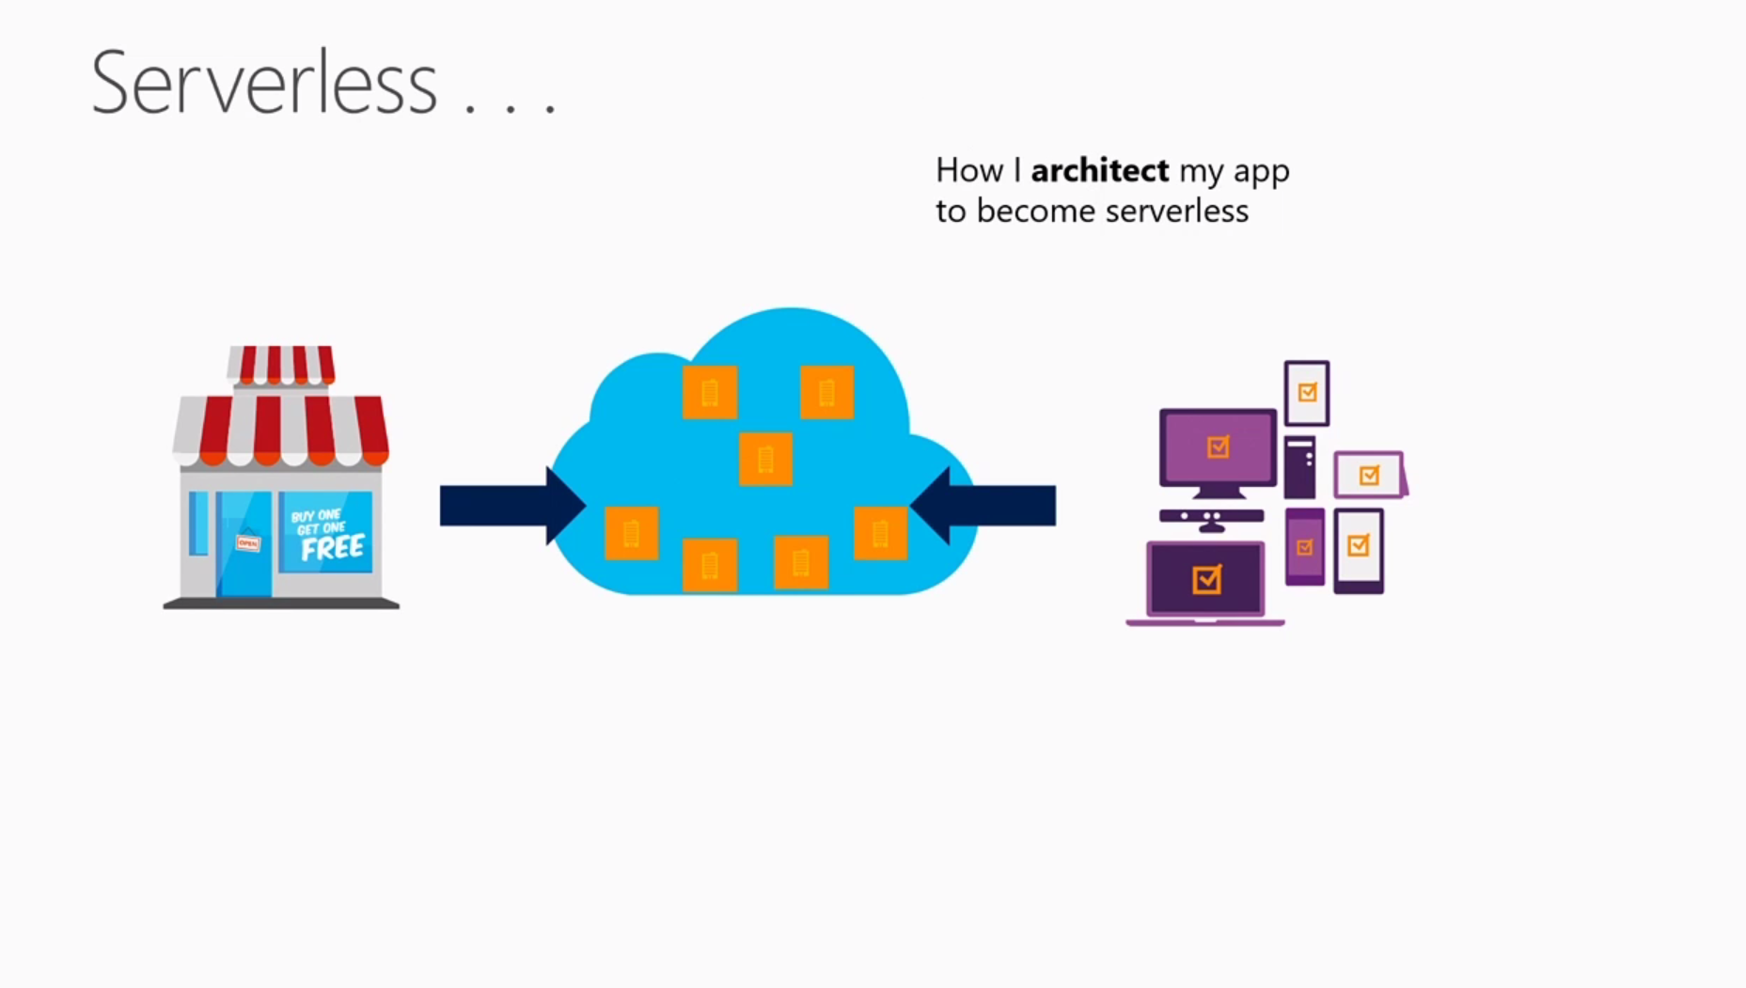
What is Serverless?
Source: Building serverless applications With Azure

Slide 16
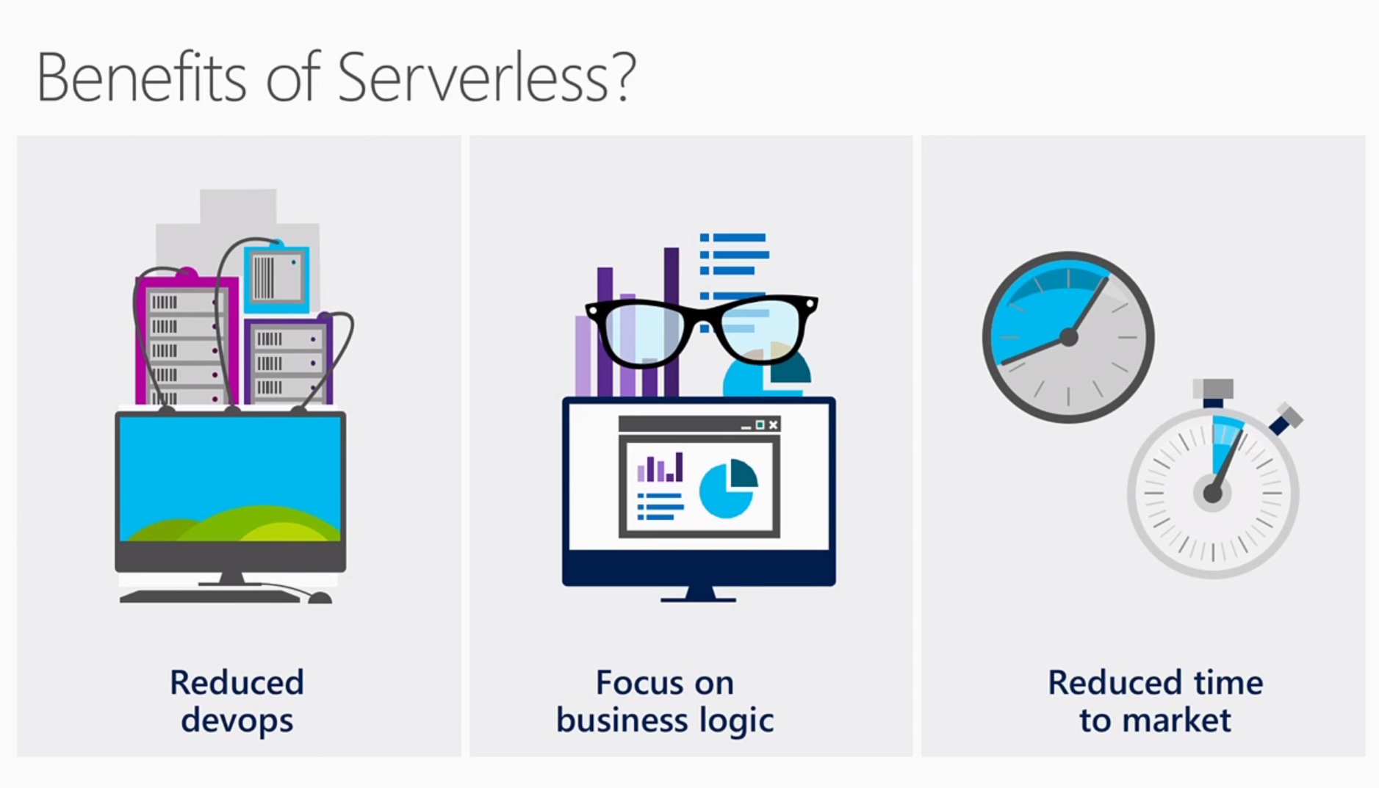
What is Serverless?
Source: Building serverless applications With Azure

Slide 17
What is Serverless?
"Serverless Computing" doesn't really mean there's no server.
Serverless means there's no server you need to worry about. That might sound like PaaS, but it's higher level that than.
- Scott Hanselman.

Slide 18
What is Serverless?
All design is about tradeoffs. On the one hand, serverless applications can be made to scale more easily.
On the other hand, the conceptual overhead of splitting a single application into something that woven from a fabric of services is significant and increases with the number and variety of services used. Lastly, they are easier to operate and maintain. Third-party services spend significant resources on security, availability, scaling and performance. It falls on development teams to design for failure.
Source: https://martinfowler.com/bliki/Serverless.html

Slide 19
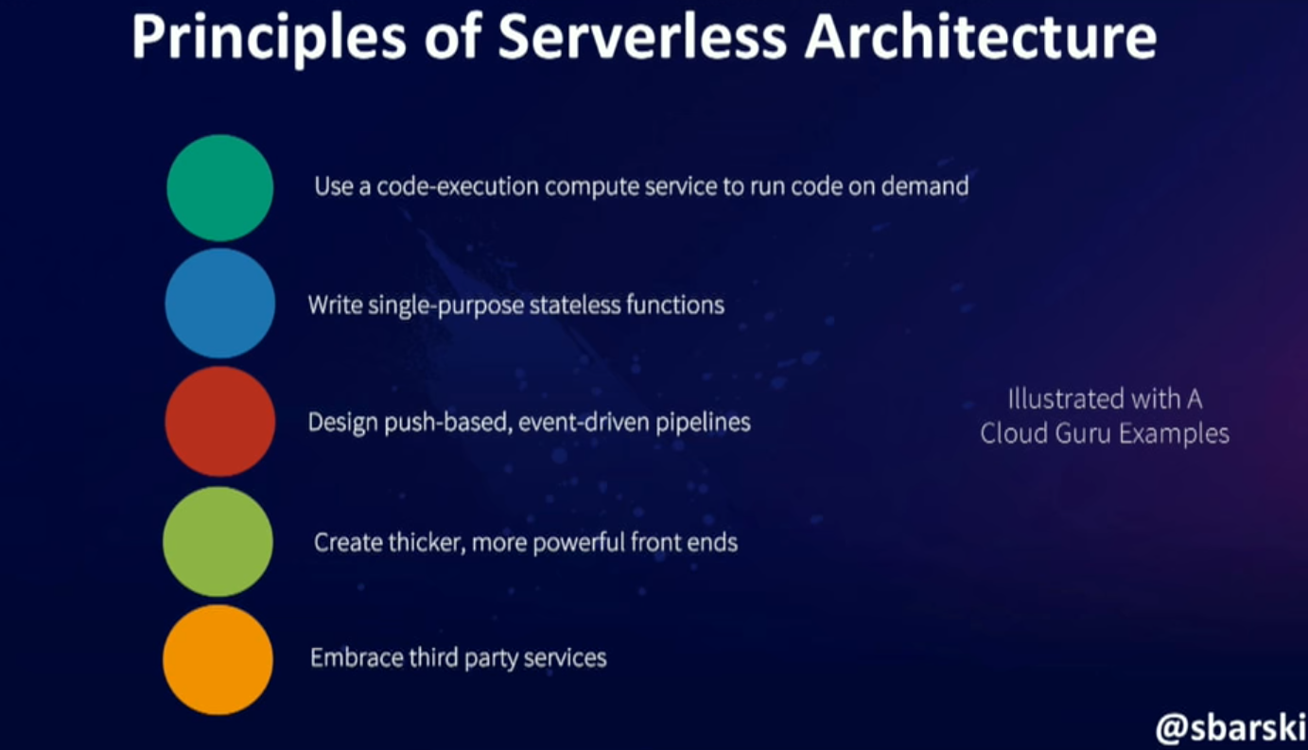
What is Serverless?
Source: Serverless: The future of Software Architecture – Peter Sbarski

Slide 20
What is Serverless?
1. Use a compute service to execute code on demand. Your main focus is to solve an interesting problem. You only pay for the time that executes (miliseconds, not hours).
Source: Serverless: The future of Software Architecture – Peter Sbarski

Slide 21
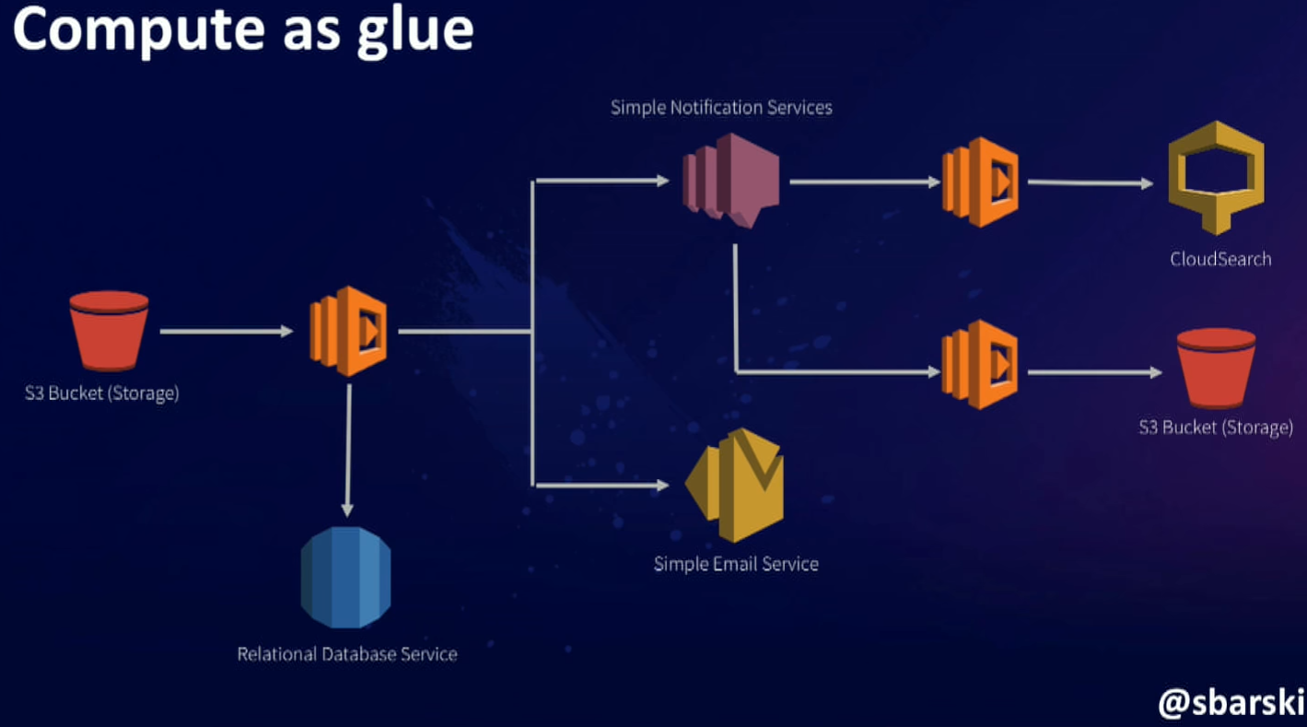
What is Serverless?
Source: Serverless: The future of Software Architecture – Peter Sbarski

Slide 22
What is Serverless?
2. Write single purpose function. A function that does one thing is more robust and easy to manage. Write stateless. No resources will survive.
Source: Serverless: The future of Software Architecture – Peter Sbarski

Slide 23
What is Serverless?
3. Design push based event driven pipelines. In event driven pipelines, you kick off an event, and that event continuous to propagate further. Ex: Write a message -> Consume the message -> Deserialize -> Write it back to another queue -> Stream Analytics can consume it.
Source: Serverless: The future of Software Architecture – Peter Sbarski

Slide 24
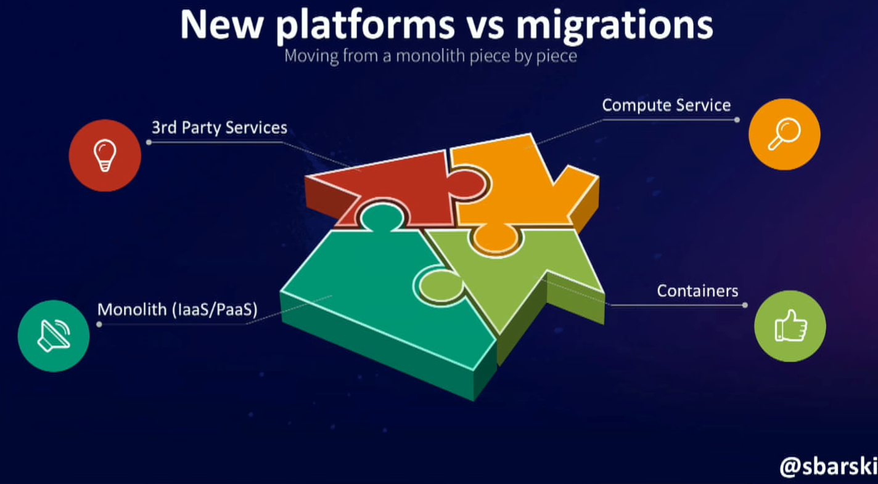
What is Serverless?
Source: Serverless: The future of Software Architecture – Peter Sbarski

Slide 25
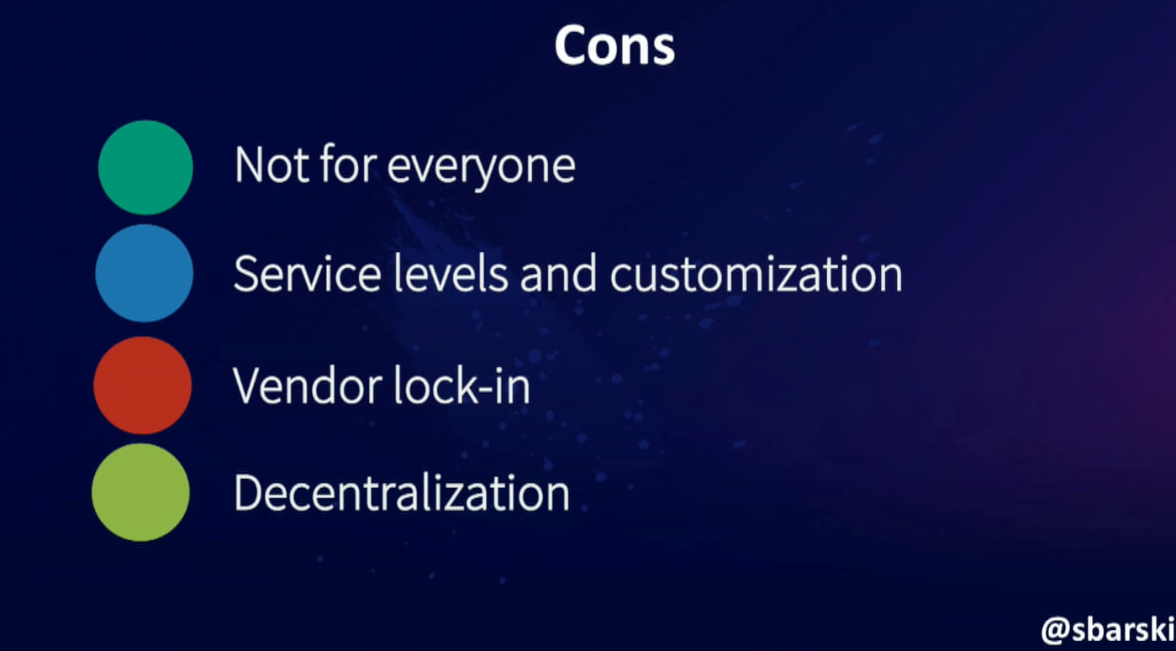
What is Serverless?
Source: Serverless: The future of Software Architecture – Peter Sbarski

Slide 26
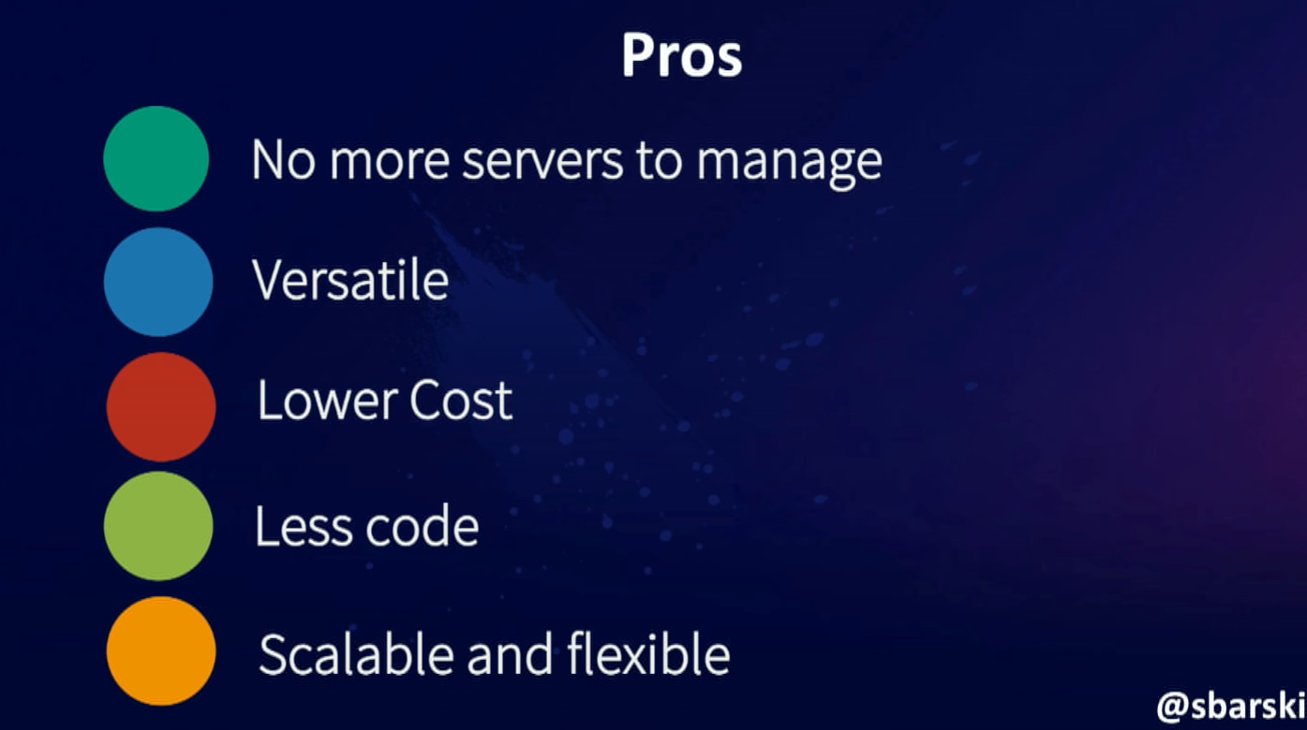
What is Serverless?
Source: Serverless: The future of Software Architecture – Peter Sbarski

Slide 27
EVERYTHING LOOKS AWESOME, RIGHT?

Slide 28
WHAT HAPPENS IF MY SERVICE GOES DOWN?

Slide 29
Your culture is the key to success
You have to care about operational concerns: Design, Resiliency, Security, Storage, Instrumentation, Metrics and Debuggability. No matter how pretty the abstractions are, you are still dealing with dusty old concept: persistent state, queries, unavailability, etc. You own these things, even if you don’t run them.

Slide 30
Your culture is the key to success
Operations is the sum of all of the skills, knowledge and values that your company has built up around the practice of shipping and maintaining quality systems and software.
It’s your implicit values as well as your explicit values, habits, tribal knowledge, reward systems.
Everybody from tech support to product people to CEO participates in your operational outcomes, even though some roles are obviously more specialized than others.

Slide 31
AND NOW LET’S GO FOR AZURE FUNCTIONS

Slide 32
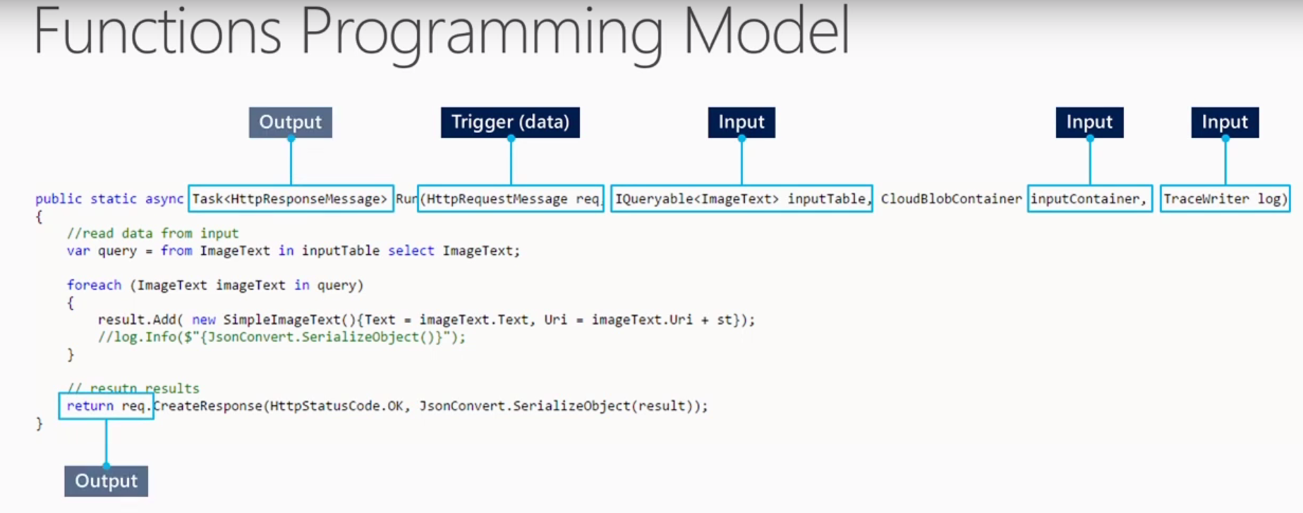
Azure Functions
Source: Building serverless applications With Azure

Slide 33
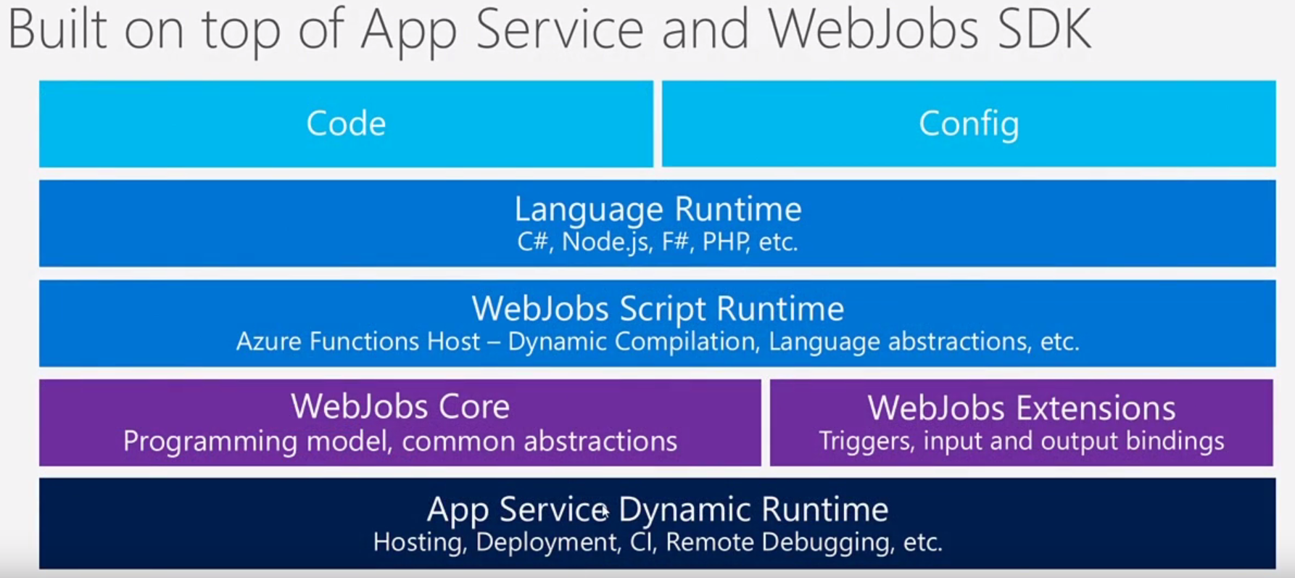
Azure Functions
Source: Building serverless applications With Azure

Slide 34
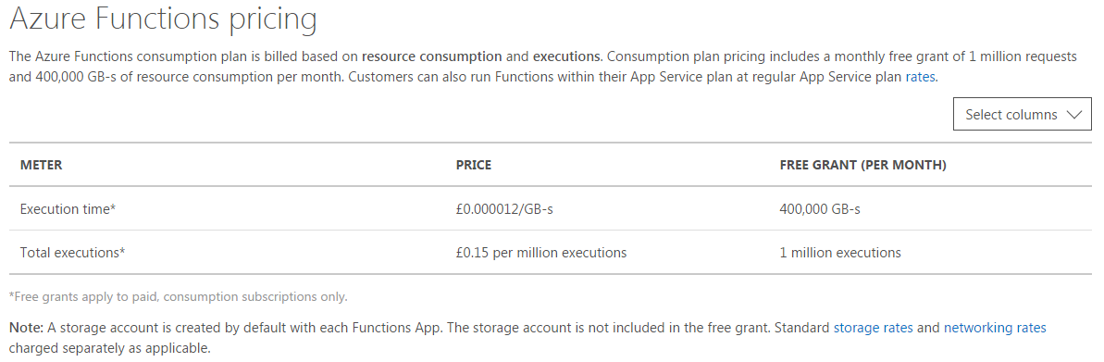
Azure Functions
Source: Azure Functions Pricing

Slide 35
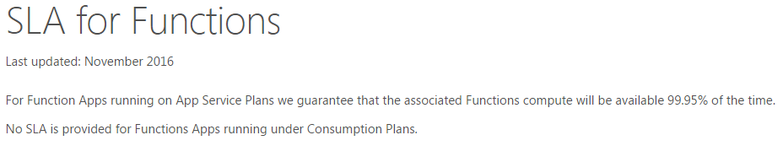
Azure Functions
Source: Azure Functions Pricing

Slide 36
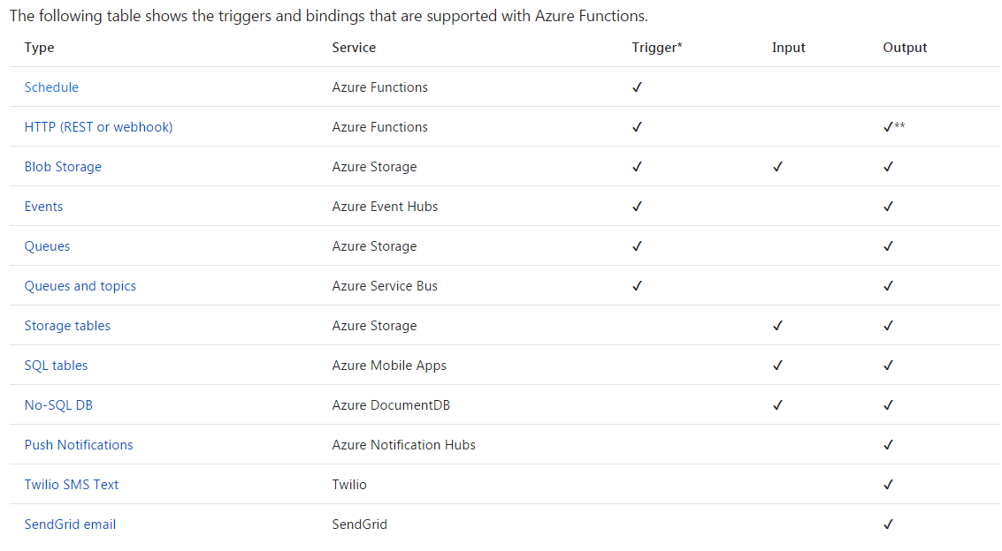
Types of functions
Source: Azure Functions Pricing

Slide 37
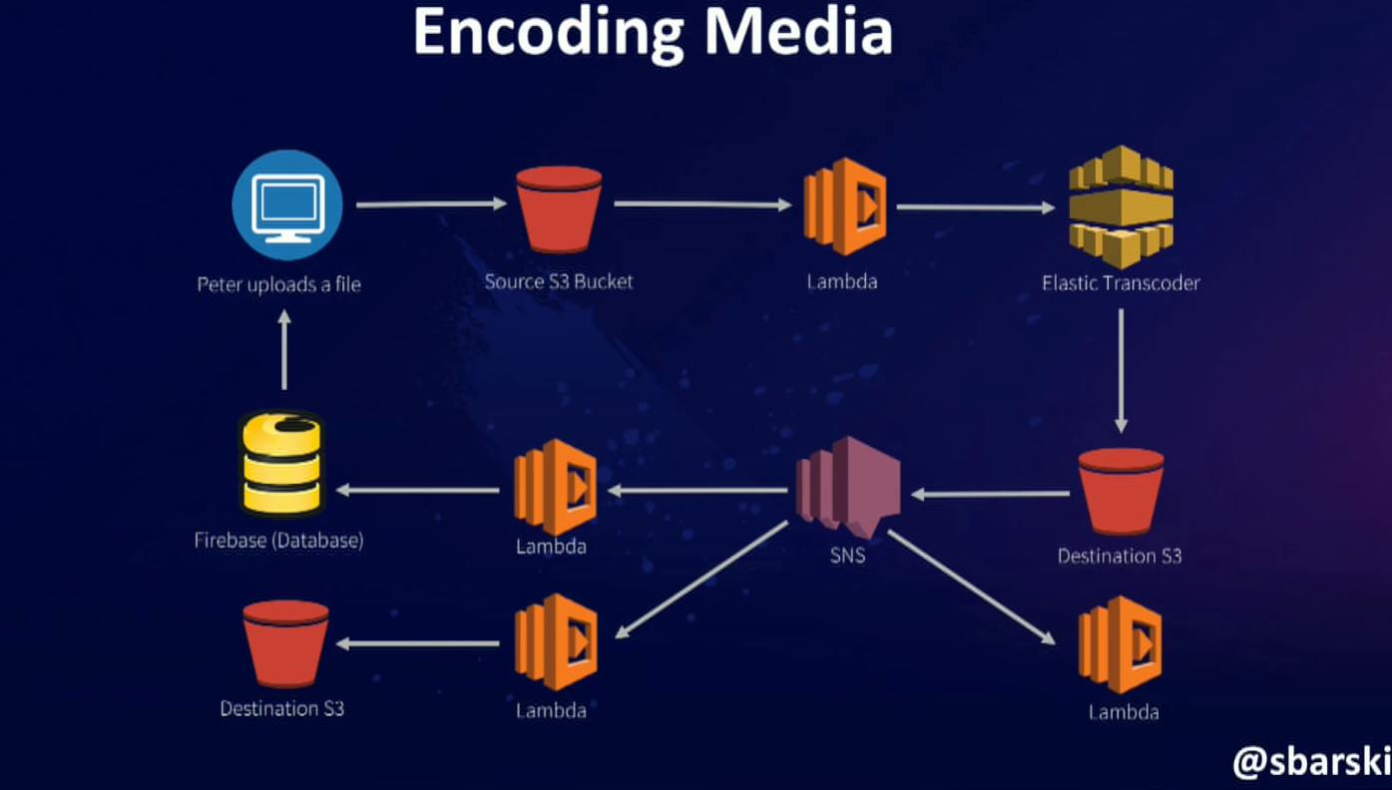
Common scenarios for Serverless Architecture
All push based design
Source: Serverless: The future of Software Architecture – Peter Sbarski

Slide 38
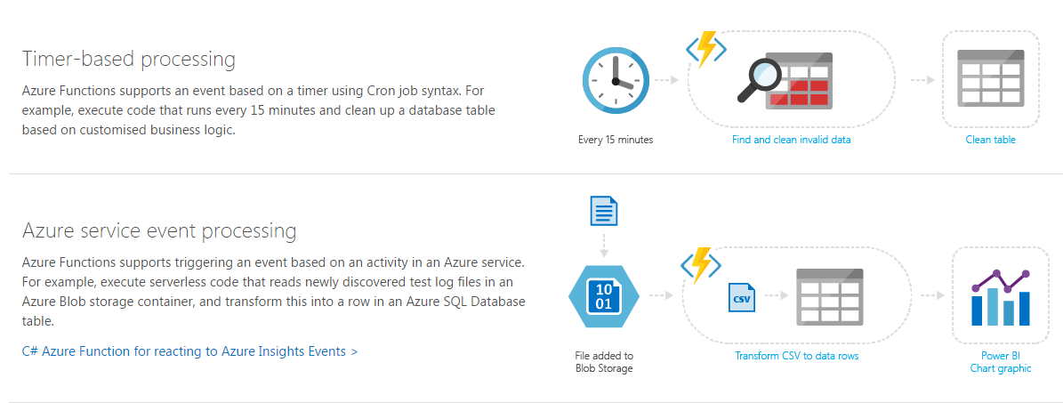
Common scenarios for Serverless Architecture
Source: Azure Functions

Slide 39
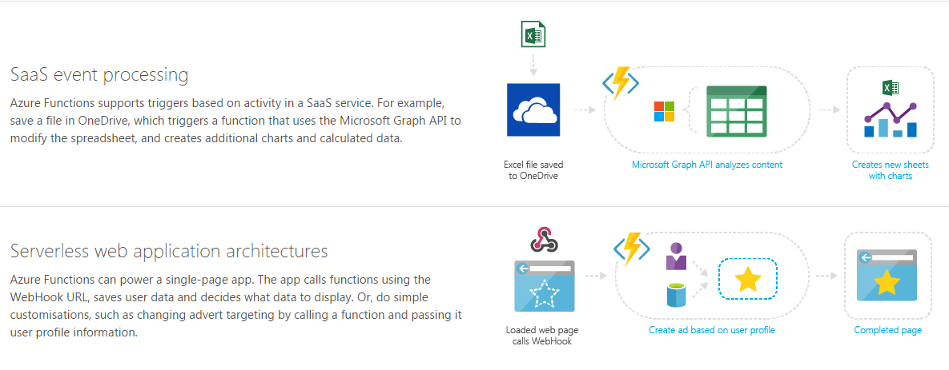
Common scenarios for Serverless Architecture
Source: Azure Functions

Slide 40
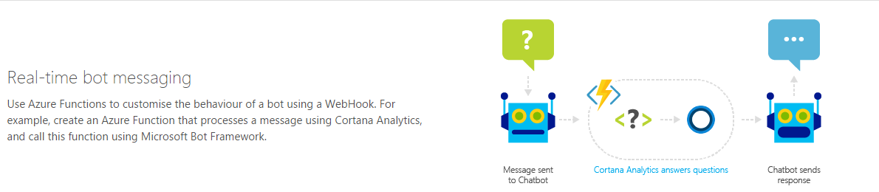
Common scenarios for Serverless Architecture
Source: Azure Functions

Slide 41
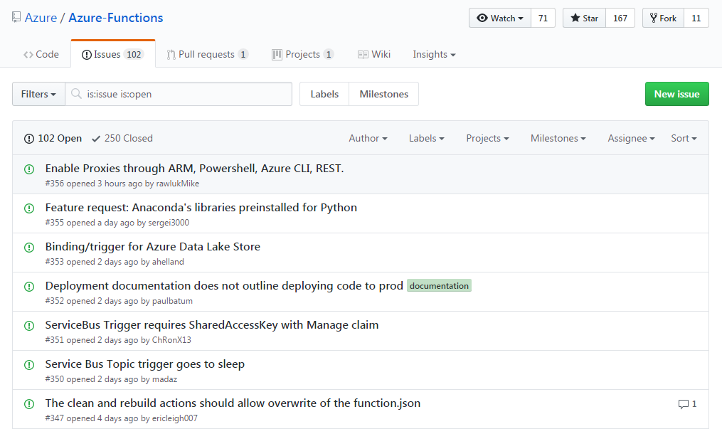
IT’S OPEN SOURCE
https://github.com/Azure/Azure-Functions

Slide 42
DEMO TIME

Slide 43
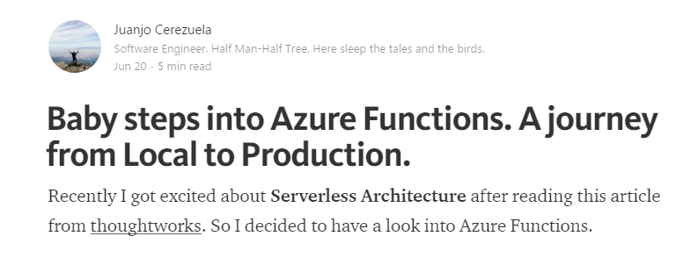
Wanna get started?
https://medium.com/@PliyoSan/azure-functions-reading-from-asb-d9fdb35b9744

Slide 44
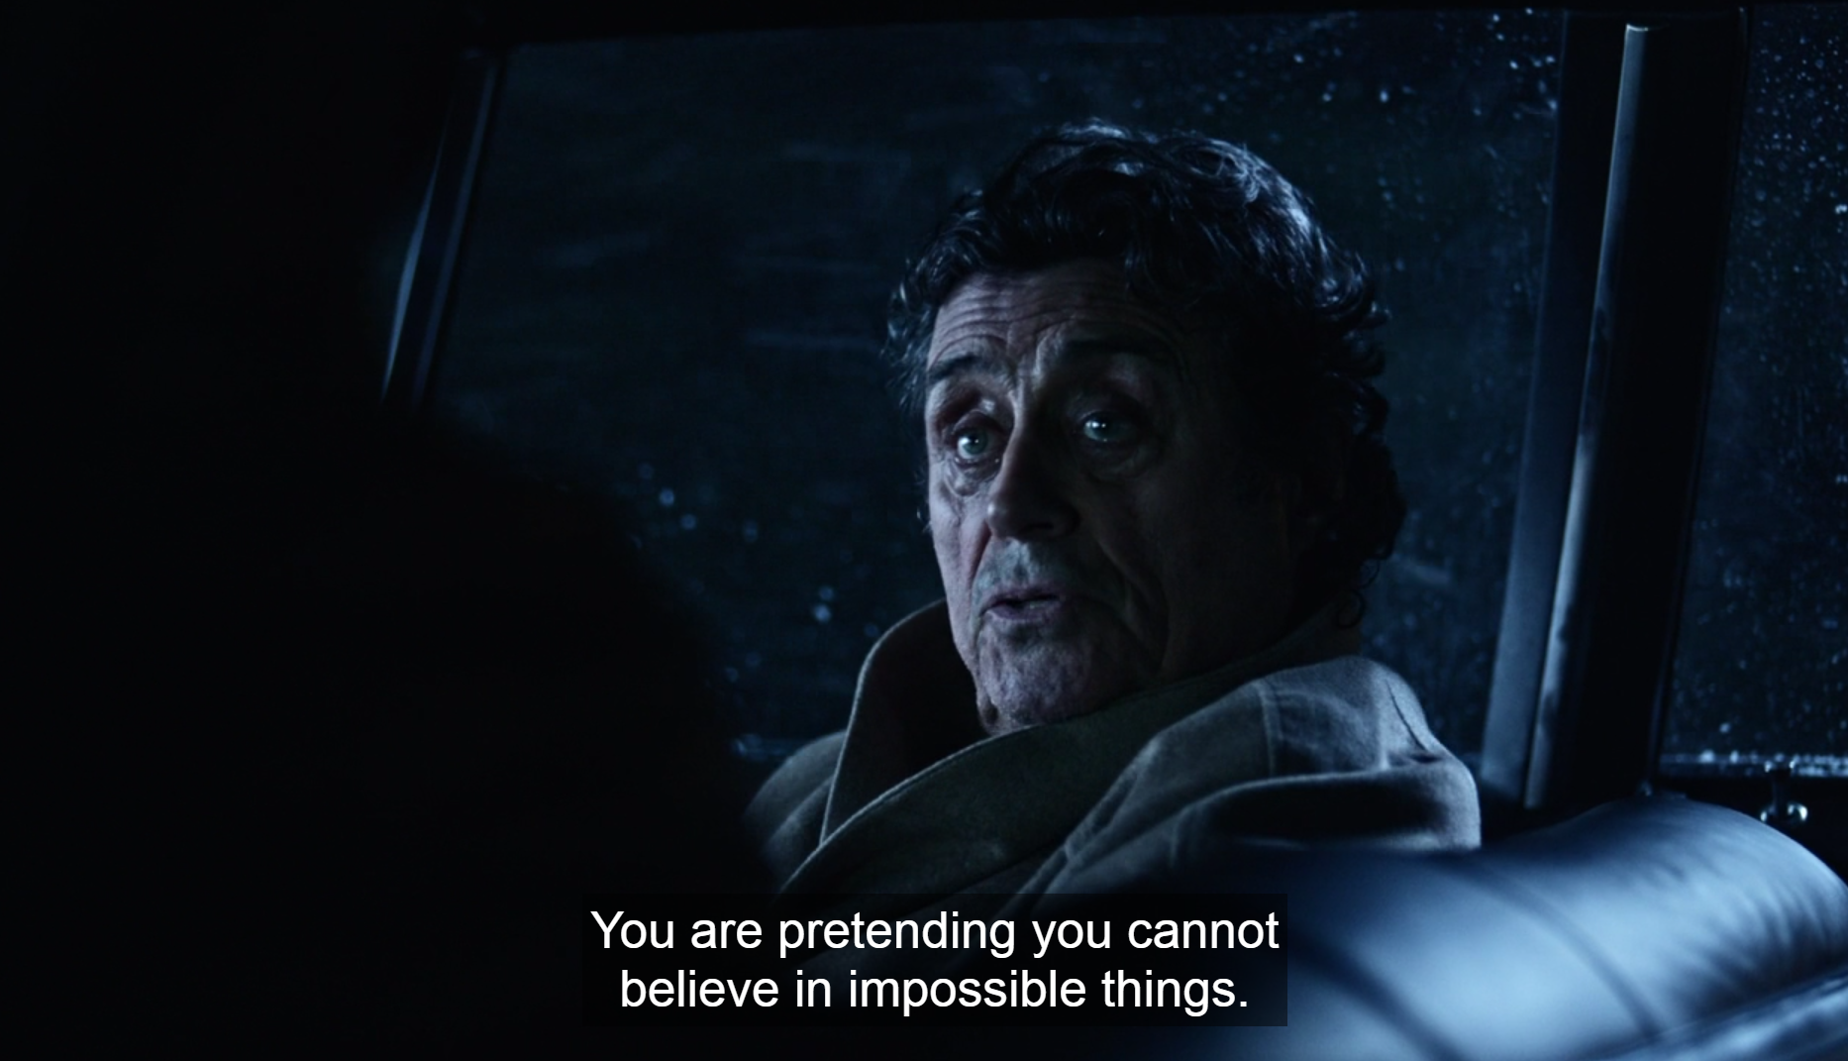

Slide 45


